Slide 1
Capstone Project: Instacart Market Basket Analysis
Anushree Srinivas
Mentor: Srdjan Santic

Slide 2
Problem to be solved and Motivation
Instacart, a grocery ordering and delivery app, aims to make it easy to fill your refrigerator and pantry with your personal favorites and staples when you need them
Currently they use transactional data to develop models that predict which products a user will buy again, try for the first time, or add to their cart next during a session
The objective of this capstone is to address two research questions:
Predict whether a product will be reordered or not in the future by the customer
Predict which department will the next product ordered belong to
The ability to identify which products the customers are likely to purchase again, and automatically adding those to cart through obtained predictions or provide a seamless interface for doing so will enhance their user experience

Slide 3
Client
Instacart is looking to use this analysis to better serve their customers.
The data science team at Instacart will be the client for which the conducted data analysis as part of the capstone project will be beneficial.

Slide 4
Feature Engineering for prediction of Reordered products
Order related features
Order_id
Order_number
Average_days_between_orders
Nb_orders(Number of orders)
Average_basket
Total items
Aisle
Department
Product
User_id
Time related features
Order_hour_of_day
Order_dow(day of week)
Days_since_prior_order
Days_since_ratio

Slide 5
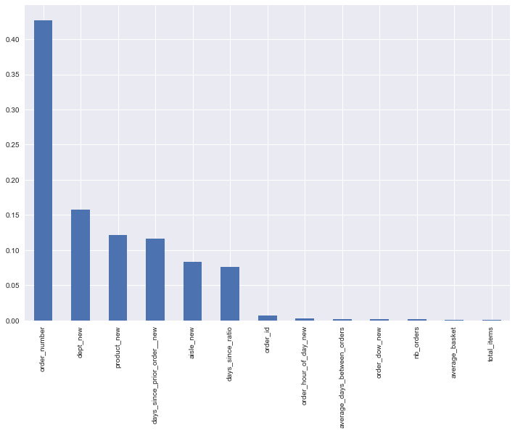
Important Features for Reordered Products
Top 5 important features are:
Order number
Department
Product
Days since prior order
Aisle

Slide 6
Feature Engineering for Department prediction
Order related features
Order_id
Order_number
Average_days_between_orders
Nb_orders(Number of orders)
Average_basket
Orders
Reorders
Reordered rate
Total items
User_id
Time related features
Order_hour_of_day
Order_dow(day of week)
Days_since_prior_order
Days_since_ratio

Slide 7
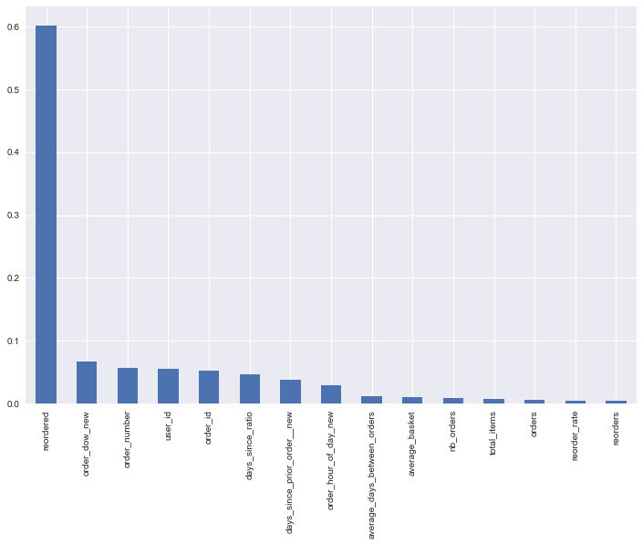
Important Features for department prediction
Top 5 important features are:
Reordered
Day of week
Order number
User id
Order id

Slide 8
Exploratory Data Analysis
The number of orders is maximum on Sunday followed by Monday.
Thursday has the least number of orders.
Most orders on Sunday are placed between 2-3pm.
On Mondays, most orders are placed between 9-11AM.
Weekends, peak orders are in the afternoon from 2-4pm.
Whereas in the weekdays, it's in the morning from 10AM-12PM.

Slide 9
Exploratory Data Analysis
Customers generally order weekly. And there’s a monthly peak as well.
Most ordered products are fruits like bananas, strawberries and organic products.
The fresh food and fresh vegetables aisles are the most frequently visited.
Department wise frequency is most for produce and dairy eggs.
Most products are reordered on Sunday followed by Monday and Saturday
Most products are reordered from 10-11AM followed by 1-3pm.

Slide 10
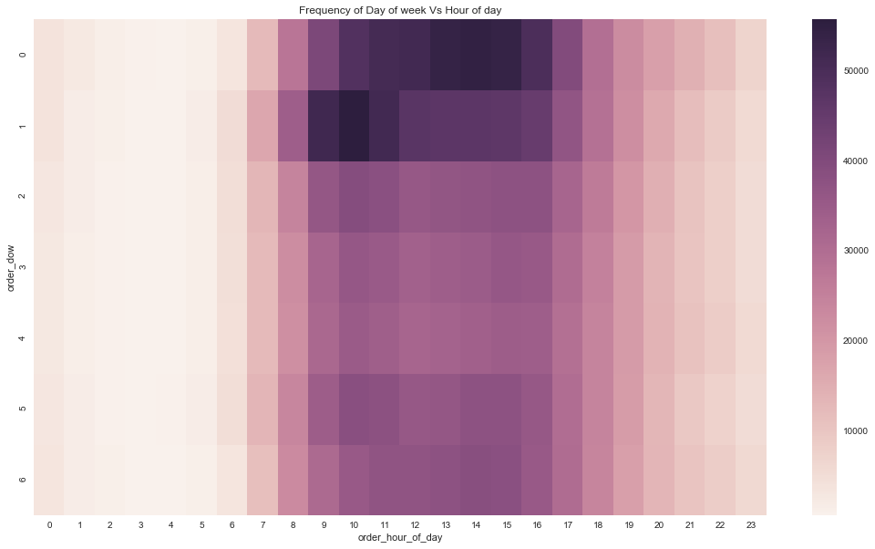
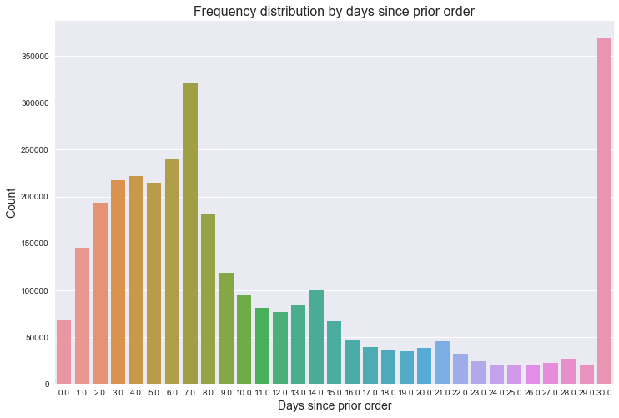
Visualizing Instacart User Behavior

Slide 11
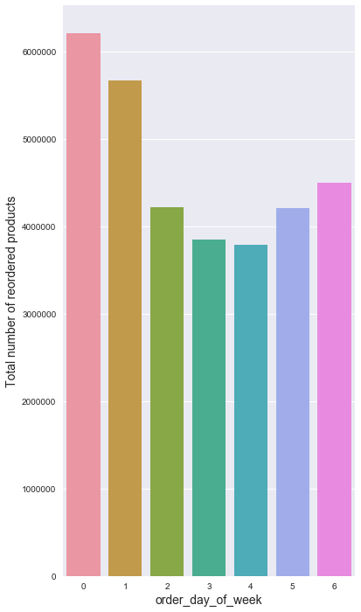
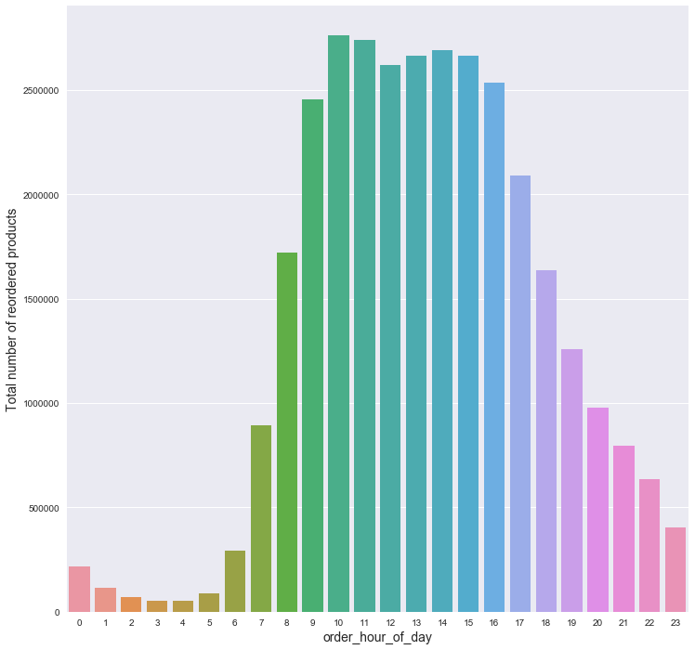
Visualizing Instacart User Behavior

Slide 12
Algorithms and Results
Research question 1: Predict a product will be reordered or not
Models | Accuracy Score
Logistic Regression | 59.7%
AdaBoost Classifier | 65.6%
RandomForest Classifier | 66.6%
Gradient Boosting Classifier | 67.1%

Slide 13
Algorithms and Results
Research question 2: Predict the department from which a product will be ordered
Models | Log loss score
Random Forest Classifier | 2.342
Gradient Boosting Classifier | 2.344
Adaboost Classifier | 2.979

Slide 14
Recommendations for the Client
These analyses can be used to run promotional and marketing campaigns targeting specific customers during peak time.
The insights generated can be used to provide a seamless interface to enhance customer’s user experience by knowing about the customer’s reordered products and automatically adding those to cart.
Personalized communications can be sent to customers’ preferences, reminding them to order again.
To improve customer satisfaction by timely delivery and reduce wait time, the shopper base can be increased by hiring new shoppers who can especially work around the peak time.

Slide 15
Future Research
Try non-linear models: The models that were used in here were all linear models. Non-linear models could be implemented to see if better results can be achieved.
For better predictions, market basket algorithms such as apriori can be implemented.
For predicting whether a product is reordered or not, algorithms that predict binomial categories better can be used.
For predicting a multi-category variable like department, other multi-nomial algorithms can be applied.
New features: New features could be created to help us generalize better on the test dataset thereby achieving better results.

